Slide 1
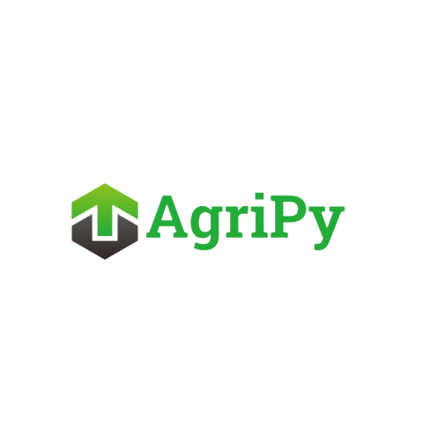
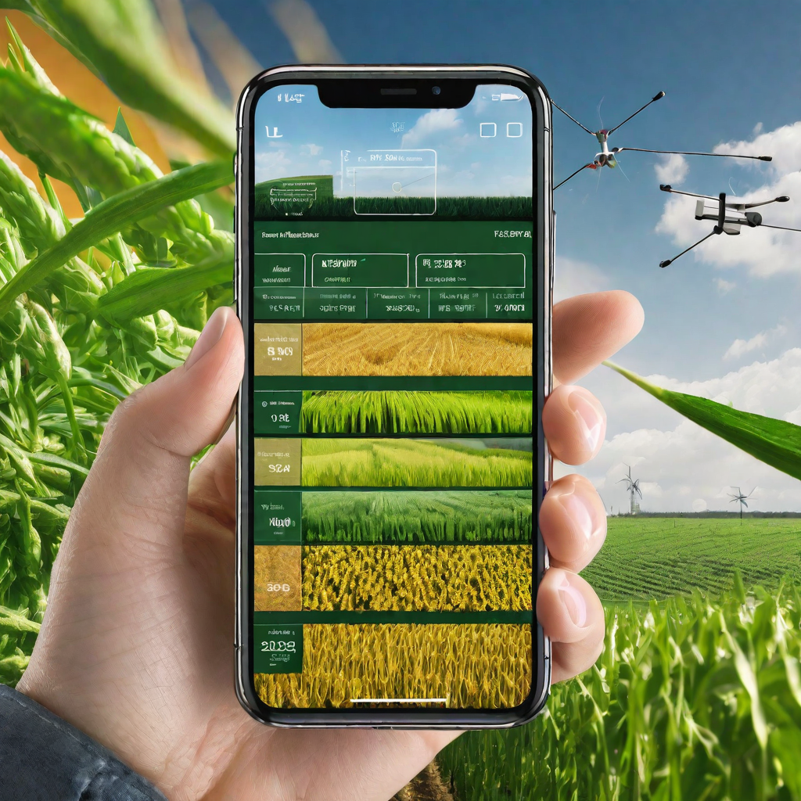
: Smart Agricultural Monitoring System
Atharva Rajendra Joshi - 101149
Atharva Vishwas Deshpande - 101161
Revati Tushar Aute - 101153
Pragati Shidarayagouda Patil - 101147
Manas Girish Kulkarni - 101158
Class: FY Division: A Batch: A3

Slide 2
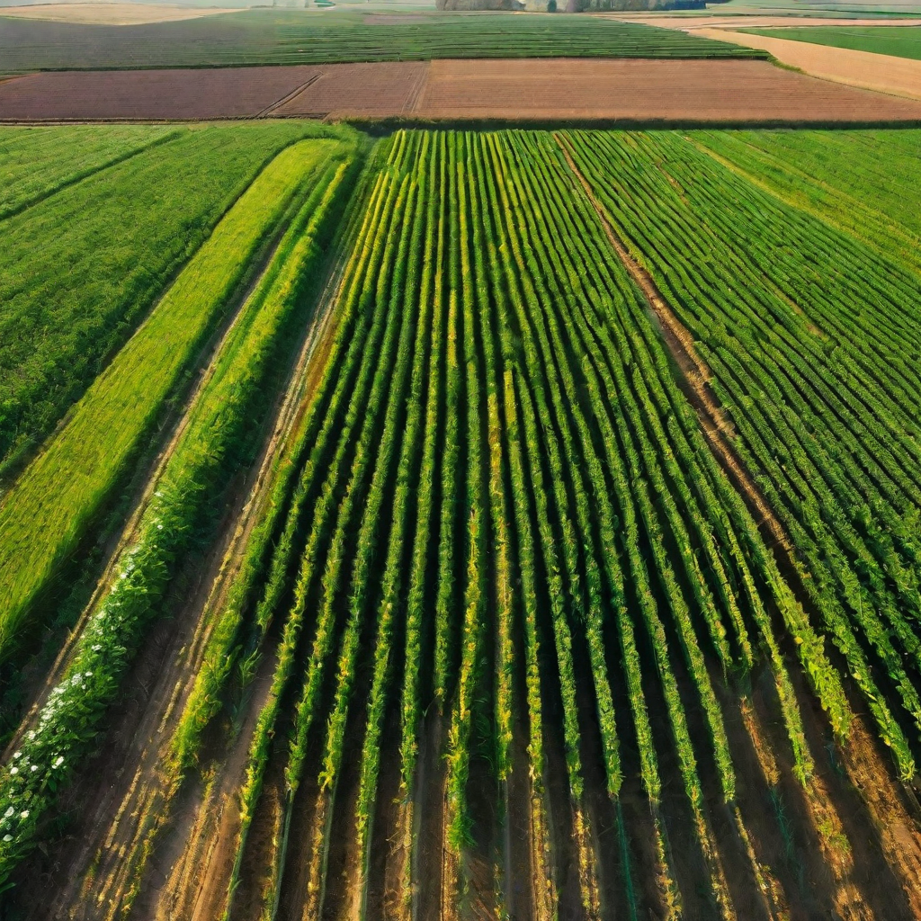
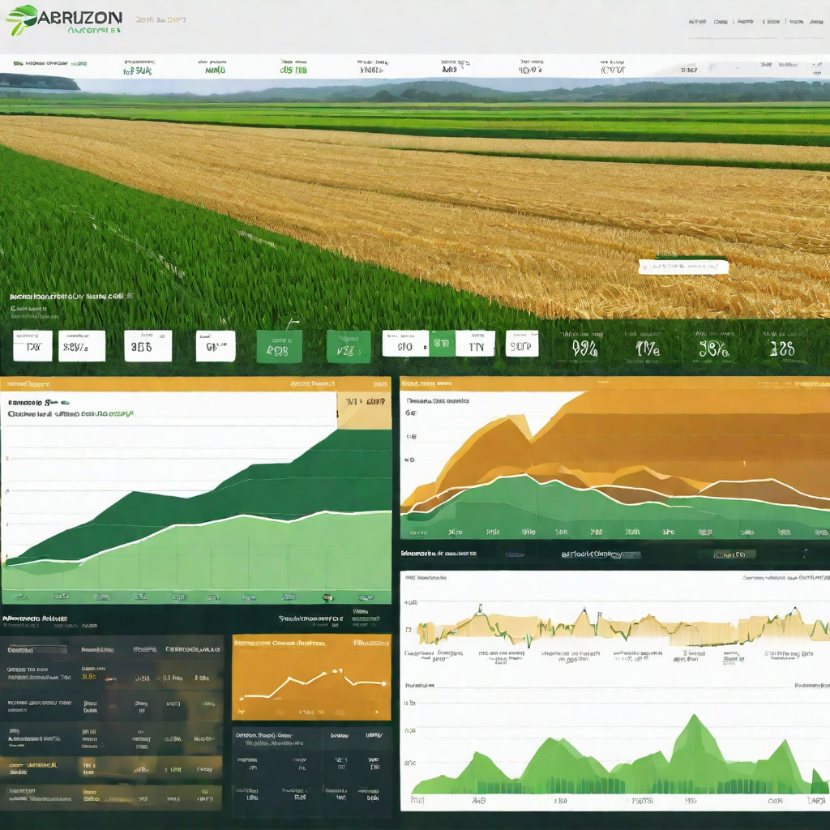
Abstract
AgriPy is Python-based project that aims at transforming agriculture by incorporating Computer Science and Technology. It covers modules like Water management, Automation for Agriculture, Predicting Crop Yields, Logistics and Supply Chains, Plant Disease Detection, Crop Simulation and Livestock Management.
Each module plays a crucial role in providing farmers with valuable insights and tools. Programming concepts like Tkinter (GUI framework), OpenWeatherMap API, Data Analysis with Numpy and Pandas, Linear Regression Module, File Handling (JSON), Image processing with OpenCV and PIL, Datetime Module, Styling & Theming have been used. This presentation showcases the highlights of the code in an interactive way.

Slide 3
Flow of Program
Main window
Our AgriPy program follows a specific flow, involving several stages and processes as displayed in this flowchart
If Invalid Choice is Entered
Respective code window opens
Error is displayed
If Invalid Choice is Entered
Error is displayed
User enters the required input
Output is displayed

Slide 4
List of the Topics / Concepts Which are Covered from the Syllabus
Water Management, Automation for Agriculture, Logistics & Supply Chain
Function calling
If-else statements
User-defined functions
Predict Crop Yield
List
Arithmetic Operators(Division)
Range
Function calling
Plant Disease Detection & Livestock Management
Function calling
If-else statements
User-defined functions
Crop Simulation
Math library
Function calling
If-else statement
User-defined functions

Slide 5
List of the Topics / Concepts Which are Out of The Syllabus
Water Management, Automation for Agriculture, Logistics & Supply Chain
Tkinter
Datetime library
Weather API
Loops
If-else statements
User-defined functions
Predict Crop Yield
List
Arithmetic Operators(Division)
Range
Function calling
Plant Disease Detection & Livestock Management
Tkinter
Cv2 library
Class
Image processing
File handling
Messagebox
Simpeldialog
Class
Constructors
json
Crop Simulation
Math library
Function calling
If-else statement
User-defined functions

Slide 6
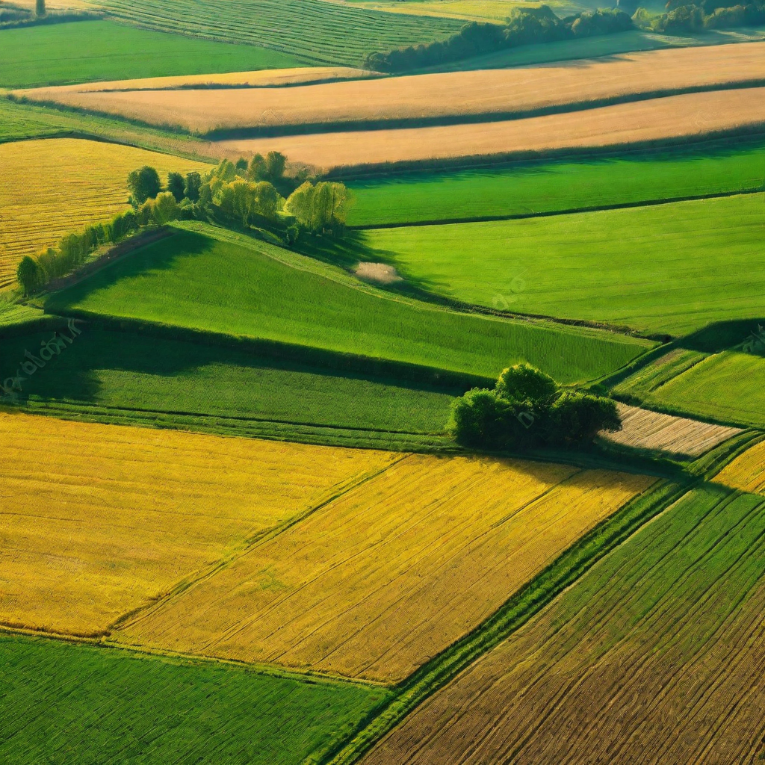
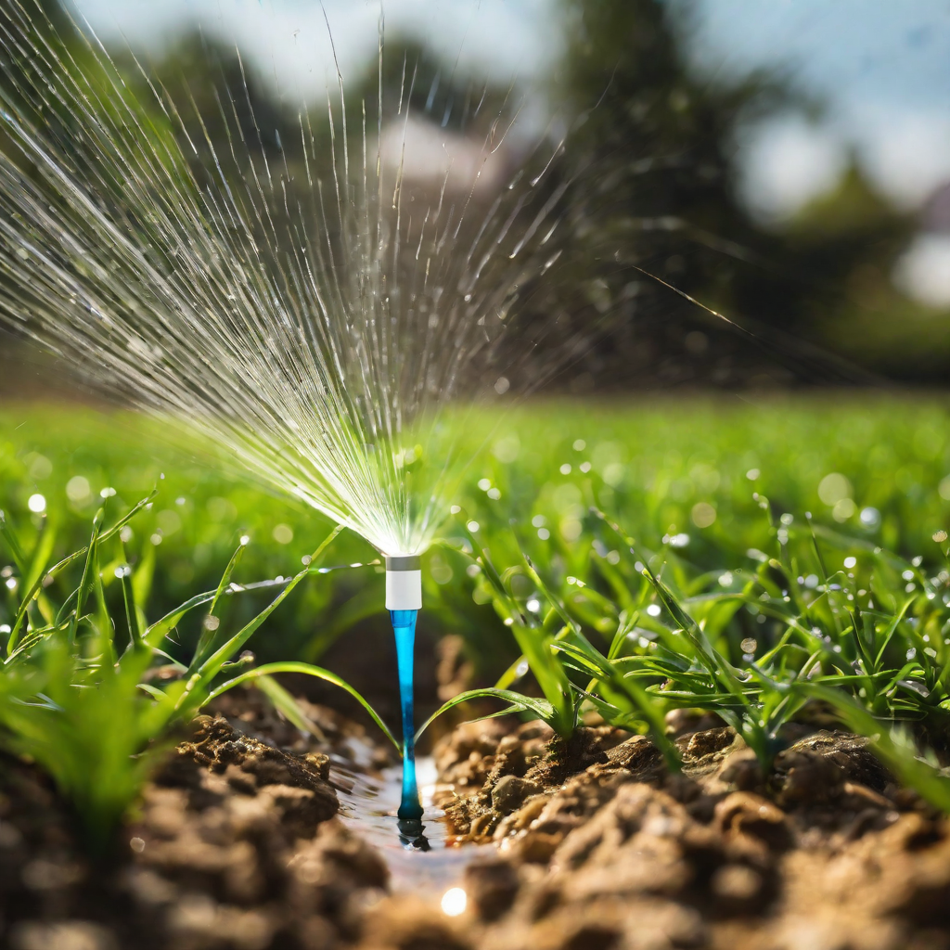
Conclusion
AgriPy is a helpful tool for farmers, making farming smarter and more efficient. As we wrap up this project, it’s evident that the integration of Python programming, data analysis, and various technologies has provided us with a practical application of our academic knowledge. We have learned how to address real-world challenges in the agriculture sector. The collaborative nature of the project has honed our teamwork and communication skills, essential for successful project execution. Building a graphical user interface using Tkinter, integrating external APIs like OpenWeatherMap and going out of the way to learn new things have expanded our technical skill set significantly. As India is an Agrarian economy, it is important that we address real-world agricultural issues and make a positive contribution to society.

Slide 7


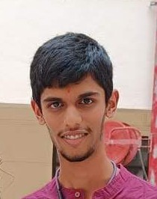
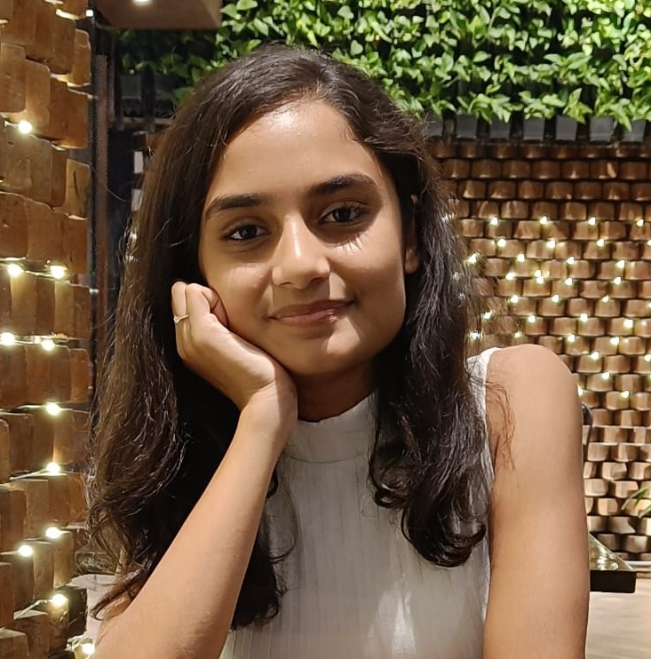
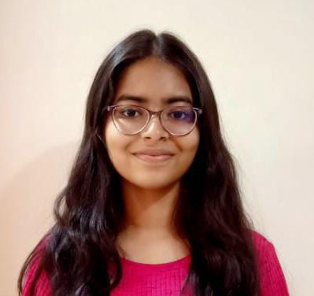
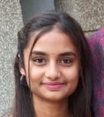
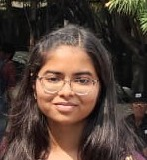
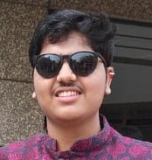
Pragati Patil
(Team Leader)
Atharva Joshi
(Project Supervisor)
Manas Kulkarni
(Team Coordinator)
Atharva Deshpande
(GUI Developer)
Revati Aute
(Presentation Designer)
Acknowledgement
Code with Harry Python Playlist: https://bit.ly/3N9VVYw
Tkinter Tutorial Playlist: https://bit.ly/482v5JZ
GeeksforGeeks: https://www.geeksforgeeks.org/python-gui-tkinter/
TutorialsPoint: https://www.tutorialspoint.com/python/python_gui_programming.htm
Disclaimer: The images used in this presentation are for representation purposes only.
Actual output images are included in the Final Report.
© AgriPy™ All Rights Reserved

Slide 8
Thank You

